Slide 1
Regression Analysis
Multiple Linear Regression
Nicoleta Serban, Ph.D.
Professor
School of Industrial and Systems Engineering
Predicting Demand for Rental Bikes: Regression Analysis

Slide 2

About This Lesson

Slide 3
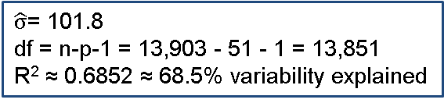
Linear Regression Analysis in R
# Applying multiple linear regression model
model1 = lm(cnt ~ .,data=train)
summary(model1)
⋮
---
Signif. codes: 0 '***' 0.001 '**' 0.01 '*' 0.05 '.' 0.1 ' ' 1
Residual standard error: 101.8 on 13851 degrees of freedom
Multiple R-squared: 0.6852, Adjusted R-squared: 0.684
F-statistic: 591 on 51 and 13851 DF, p-value: < 2.2e-16
 | Estimate | Std. Error | t value | Pr(>|t|)
(Intercept) | -79.4356 | 7.4390 | -10.678 | < 2e-16 ***
season2 | 34.9268 | 5.4110 | 6.455 | 1.12e-10 ***
season3 | 27.0055 | 6.4438 | 4.191 | 2.80e-05 ***
season4 | 65.3435 | 5.4690 | 11.948 | < 2e-16 ***
yr1 | 85.3415 | 1.7487 | 48.804 | < 2e-16 ***
mnth2 | 4.1666 | 4.3853 | 0.950 | 0.342060
mnth3 | 16.4733 | 4.9267 | 3.344 | 0.000829***
mnth4 | 12.5834 | 7.3038 | 1.723 | 0.084936 .
mnth5 | 26.4616 | 7.8357 | 3.377 | 0.000735 ***
mnth6 | 11.5056 | 8.0535 | 1.429 | 0.153131
In the full output there are 51 predictor rows in addition to the intercept.
$\hat{σ}$= 101.8
df = n-p-1 = 13,903 - 51 - 1 = 13,851
R² ≈ 0.6852 ≈ 68.5% variability explained

Slide 4
Coding Dummy Variables in R
## Create Dummy Variables
weathersit = data$weathersit
weathersit.1 = rep(0,length(weathersit))
weathersit.1[weathersit==1] = 1
weathersit.2 = rep(0,length(weathersit))
weathersit.2[weathersit==2] = 1
weathersit.3 = rep(0,length(weathersit))
weathersit.3[weathersit==3] = 1
## Include all dummy vars without intercept
fit.1 = lm(cnt ~ weathersit.1 + weathersit.2 +weathersit.3 - 1)
## Include 3 dummy variables with intercept
fit.2 = lm(cnt ~ weathersit.1 + weathersit.2)
## Use categorical variable
weathersit = as.factor(data$weathersit)
fit.3 = lm(cnt ~ weathersit)
summary(fit.1)
 | Estimate | Std. Error | t value | Pr(>|t|)
weathersit.1 | 204.869 | 1.680 | 121.97 | <2e-16 ***
weathersit.2 | 175.165 | 2.662 | 65.80 | <2e-16 ***
weathersit.3 | 111.501 | 4.758 | 23.43 | <2e-16 ***
summary(fit.2)
 | Estimate | Std. Error | t value | Pr(>|t|)
(Intercept) | 111.501 | 4.758 | 23.43 | <2e-16 ***
weathersit.1 | 93.369 | 5.046 | 18.50 | <2e-16 ***
weathersit.2 | 63.665 | 5.452 | 11.68 | <2e-16 ***
summary(fit.3)
 | Estimate | Std. Error | t value | Pr(>|t|)
(Intercept) | 204.869 | 1.680 | 121.972 | <2e-16 ***
weathersit2 | -29.704 | 3.148 | -9.437 | <2e-16 ***
weathersit3 | -93.369 | 5.046 | -18.503 | <2e-16 ***

Slide 5
Coding Dummy Variables in R
## Create Dummy Variables
weathersit = data$weathersit
weathersit.1 = rep(0,length(weathersit))
weathersit.1[weathersit==1] = 1
weathersit.2 = rep(0,length(weathersit))
weathersit.2[weathersit==2] = 1
weathersit.3 = rep(0,length(weathersit))
weathersit.3[weathersit==3] = 1
## Include all dummy vars without intercept
fit.1 = lm(cnt ~ weathersit.1 + weathersit.2 +weathersit.3 - 1)
## Include 3 dummy variables with intercept
fit.2 = lm(cnt ~ weathersit.1 + weathersit.2)
## Use categorical variable
weathersit = as.factor(data$weathersit)
fit.3 = lm(cnt ~ weathersit)
summary(fit.1)
 | Estimate | Std. Error | t value | Pr(>|t|)
weathersit.1 | 204.869 | 1.680 | 121.97 | <2e-16 ***
weathersit.2 | 175.165 | 2.662 | 65.80 | <2e-16 ***
weathersit.3 | 111.501 | 4.758 | 23.43 | <2e-16 ***
summary(fit.2)
 | Estimate | Std. Error | t value | Pr(>|t|)
(Intercept) | 111.501 | 4.758 | 23.43 | <2e-16 ***
weathersit.1 | 93.369 | 5.046 | 18.50 | <2e-16 ***
weathersit.2 | 63.665 | 5.452 | 11.68 | <2e-16 ***
summary(fit.3)
 | Estimate | Std. Error | t value | Pr(>|t|)
(Intercept) | 204.869 | 1.680 | 121.972 | <2e-16 ***
weathersit2 | -29.704 | 3.148 | -9.437 | <2e-16 ***
weathersit3 | -93.369 | 5.046 | -18.503 | <2e-16 ***
Codding Dummy Variables
R Sets the “first” class as being the baseline
If a different class is the baseline, either use dummy variables or specify with ‘contr.treatment’
Be careful when using a model without intercept in R!
No baseline comparison

Slide 6
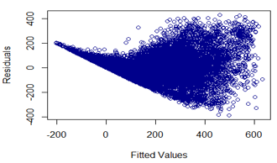
Goodness of Fit: Constant Variance Assumption
## Fitting the model
# Creating scatterplot of residuals vs fitted values
resids = rstandard(model1)
fits = model1$fitted
plot(fits,
resids,
xlab="Fitted Values",
ylab="Residuals",
main="Scatterplot",
col="darkblue")
The constant variance assumption does not hold -- the variance increases when moving from lower to higher fitted values.
The residuals, at low y values, seem to follow a straight-line pattern. The linear pattern in the beginning suggests that the response variable stays constant for a range of predictor values.

Slide 7
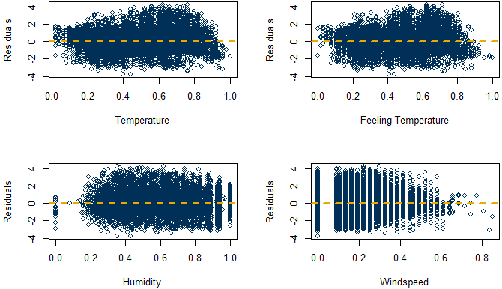
Goodness of Fit: Linearity Assumption
The residuals do not vary with the any of the numeric predicting variables. No transformation of the predicting variable is needed.

Slide 8
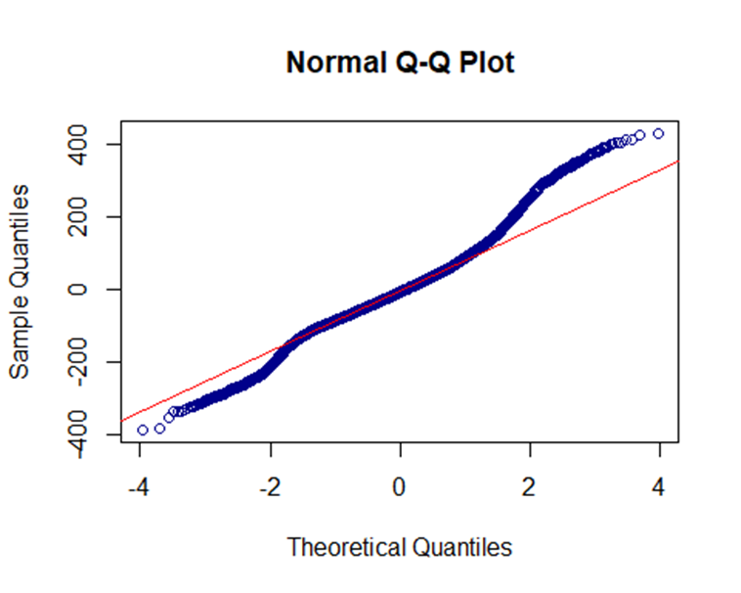
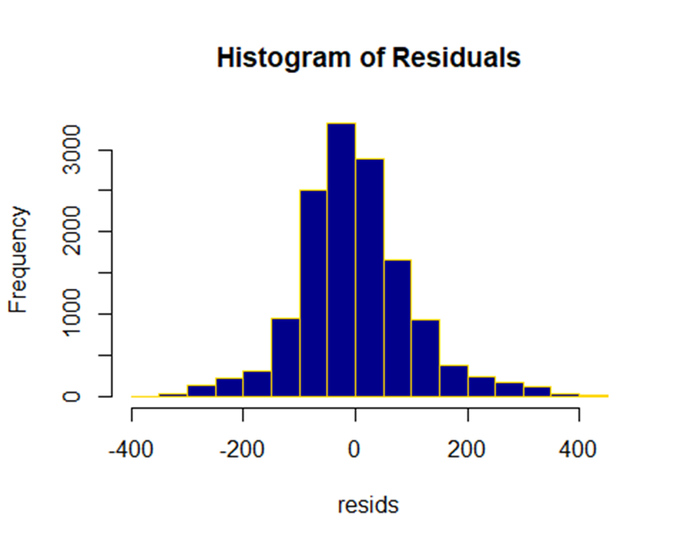
Goodness of Fit: Normality Assumption
## Checking normality
# histogram
hist(resids,
nclass=20,
col="darkblue",
border="gold",
main="Histogram of residuals")
# q-q plot
qqnorm(resids,
col="darkblue")
qqline(resids,
col="red")

Slide 9
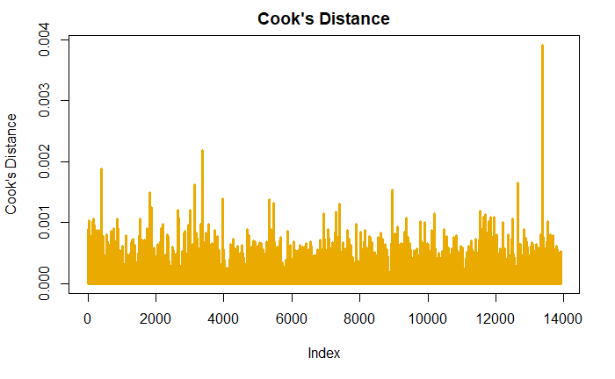
Goodness of Fit: Outliers
# Cook’s Distance
cook = cooks.distance(model1)
plot(cook,
type="h",
lwd=3,
col="darkred",
ylab = "Cook's Distance",
main="Cook's Distance")
There is one observation with a Cook’s Distance noticeably higher than the other observations. However, its Cook’s distance is close to 0.004, suggesting that there are likely no outliers.

Slide 10
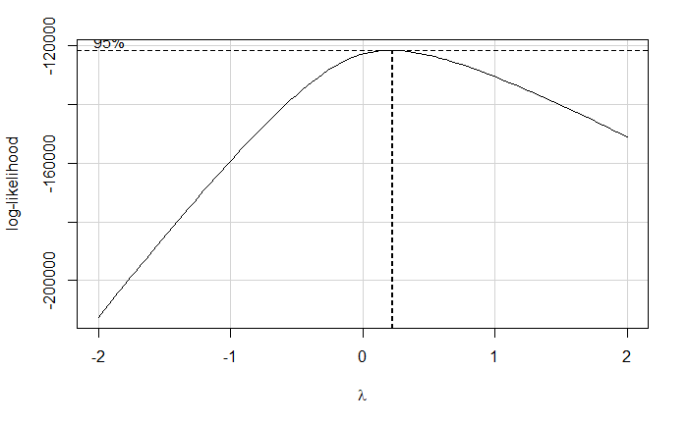
Transformation of the Response Variable
## Box Cox transformation
bc <- boxcox(model1)
lambda <- bc$x[which(bc$y==max(bc$y))]
## Fitting the model with square root transformation
model2<-lm(sqrt(cnt)~.,data=train)
summary(model2)
The optimal value of lambda or the power provided by the Box Cox transformation is 0.22.
Generally, when the response data consist of count data, a theoretically recommended transformation is the square root, corresponding to a 0.5 power transformation.

Slide 11
Regression Analysis after Transformation
## Fitting the model with square root transformation
model2<-lm(sqrt(cnt)~.,data=train)
summary(model2)
## Find Insignificant Values
which(summary(model2)$coeff[,4]>0.05)
## Multicollinearity
vif(model2)
## Model Performance
summary(model2)$r.squared
## [1] 0.786535
mnth2 mnth4 mnth6 mnth7 mnth8 mnth10 mnth11 weekday1
6 8 10 11 12 14 15 41
 | GVIF | Df | GVIF^(1/(2*Df))
season | 165.308 | 3 | 2.343
yr | 1.025 | 1 | 1.012
mnth | 323.778 | 11 | 1.300
hr | 1.771 | 23 | 1.012
holiday | 1.121 | 1 | 1.059
weekday | 1.137 | 6 | 1.011
weathersit | 1.386 | 2 | 1.085
temp | 51.283 | 1 | 7.161
atemp | 43.748 | 1 | 6.614
hum | 1.921 | 1 | 1.386
windspeed | 1.251 | 1 | 1.118
As VIFs of the season, mnth, temp, atemp factors are greater than max(10, 1/(1-R²)), it indicates there is a problem of multicollinearity in the linear model. So, we should not use all the predictors in the model.

Slide 12
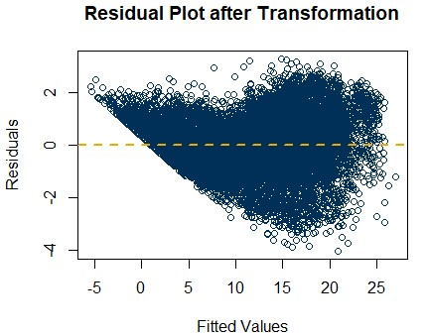
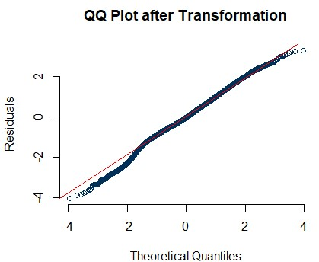
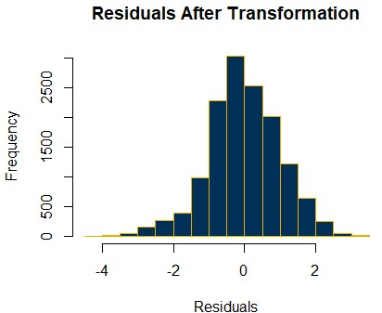
Goodness of Fit after Transformation
The constant variance assumption is still violated. The transformation has not improved the goodness of fit even though the model performance is better with respect to the coefficient of determination.

Slide 13
Removing Low Demand Data
## Remove data for hours 0-6
hrs <- as.numeric(data$hr)
data_red <- data[which(hrs>=7),]
## Test/Train Data
set.seed(9) # for uniformity
sample_size <- floor(0.8*nrow(data_red))
picked <- sample(seq_len(nrow(data_red)),size = sample_size)
train_red <- data_red[picked, -c(1,2,9,15,16)]
test_red <- data_red[-picked, -c(1,2,9,15,16)]
## Fitting the model with square root transformation
model3<-lm(sqrt(cnt)~.,data=train_red)
summary(model3)$r.squared
[1] 0.6579021
df<-which(summary(model3)$coeff[,4]>0.05)
mnth7 mnth11 mnth12 hr14 hr15 hr20
11 15 16 23 24 29

Slide 14
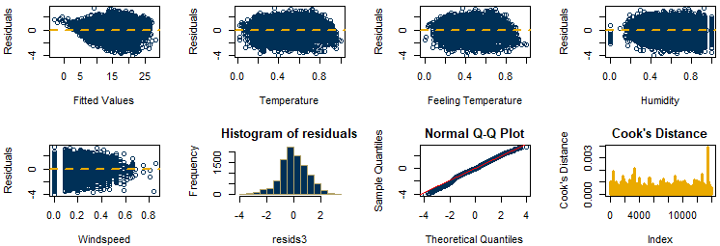
Goodness of Fit without Low Demand Data
The constant variance assumption is still violated even for the model without the low demand data and with the transformed response.
The implication of the constant variation assumption violation is that the uncertainty in predicting bike demand when in high demand will be higher than estimated using the multiple regression models in this lesson.

Slide 15

Summary

